Slide 1
Unit6-
Human Communities and the Environment
(Disaster management: Floods, earthquake, cyclones and landslides)
Lecture 25
1

Slide 2
Learning outcomes:
After completing this lecture, you will be able to understand the following:
Get knowledge about various types of disaster like Floods, earthquake, cyclones and landslides and their effect on human and Environment
Get awareness about Disaster management to reduce the effect of Disaster.
2

Slide 3
Disaster and Disaster Management
A disaster is defined as a sudden event or calamity that causes large-scale damage and destruction of human life and property.
Types of Disasters
Natural Disasters
Air-related – Hurricanes, cyclones, storms, etc.
Water-related – Floods, drought, etc.
Earth-related – Earthquakes, landslides, volcanic eruptions, etc.
Man-made Disasters
Industrial accidents ex:- Bhopal gas tragedy
Wars, riots, terrorism, etc., Ex- First and Second world war
Toxic spills, Ex- Leakage of oil due to accident in Ocean
Transportation accidents Ex- Rail accidents
https://www.youtube.com/watch?v=Kt-C8WCIWrg&has_verified=1
3

Slide 4
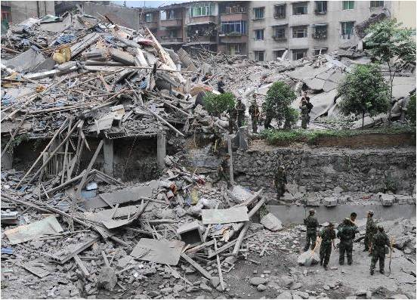
Earthquake
The term earthquake is used to describe any seismic event, caused naturally or as a consequence of human activities, that leads to the generation of devastating seismic waves.
Causes of Earthquake
Movement of hot gases and magma
Volcanic activities
Stress buildup due to water pressure
Tectonic stress generated by movement of tectonic plates
4

Slide 5
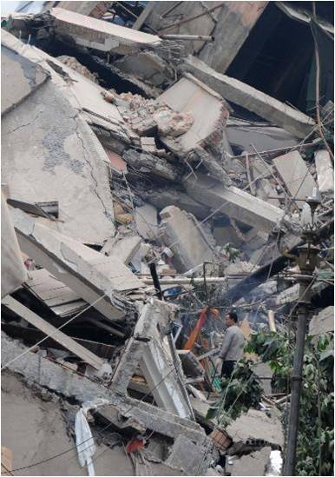
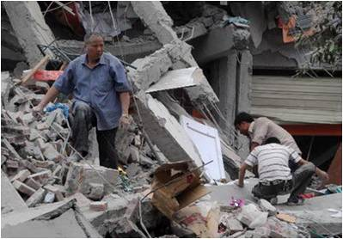
Effects of Earthquake
Destruction and demolition of buildings, dams, etc. Large-scale damage to life and property.
Increased incidence of fire, landslides, etc.
Increased incidence of tsunami waves, leading to inundation in coastal areas
https://www.youtube.com/watch?v=e7ho6z32yyo
5

Slide 6
Management of Earthquakes
Marking earthquake-sensitive areas
Construction of houses, factories, dams, bridges, etc., with appropriate design and materials and strategically placed vibration absorbers
Forecast and early prediction of earthquakes
Creating public awareness regarding the steps to be taken during emergencies
Relief measures through timely support by individuals, government, and non-governmental organizations
6

Slide 7
Landslides
Landslides are natural phenomena during which large amounts of landmass slide downwards from hilly areas, mainly because of gravity, destroying everything lying in the path.
Causes of Landslides
Earthquakes
Glaciers and Torrential rain
Construction of dams, bridges, tunnels, roads, etc
Use of explosives for breaking rocks during mining
Deforestation of mountain slopes
7

Slide 8
Effects of Landslides
Rocks, large debris, and sliding landmasses destroy urban and rural habitation
Damage to roads, dams, bridges, etc.
Obstruction of river flow increasing the incidence of flood
Severe damage to crops and agricultural lands
8

Slide 9
Management of Landslides
Construction activities should be done only after properly evaluating the geological and geographic conditions.
Regulating rate of water flow also helps in controlling landslides.
Agriculture at slopes should be avoided as far as possible.
Relief task through economic help supporting resettlement and rehabilitation of affected people at individual, community, and organizational levels should be carried out.
https://www.youtube.com/watch?v=mknStAMia0Q
9

Slide 10
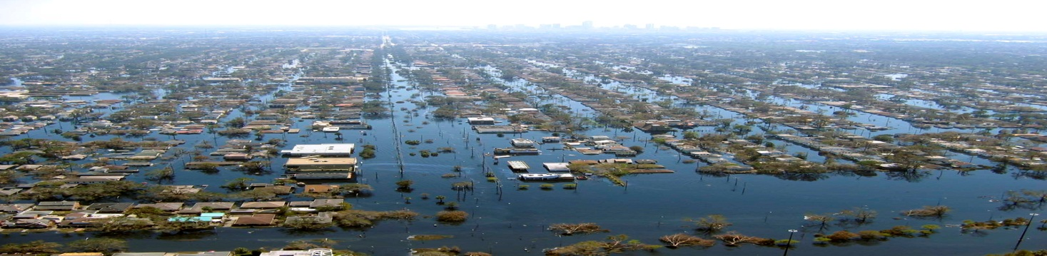
Floods
The accumulation of a large quantity of water at a place or the presence of more water that cannot be handled by the drainage of the area is known as flood.
10

Slide 11
Types of Floods
Flash floods:- A flash flood is a rapid flooding of low-lying areas: washes, rivers, dry lakes and depressions. It may be caused by heavy rain associated with a severe thunderstorm, hurricane, tropical storm, or meltwater from ice or snow flowing over ice sheets or snowfields.
River floods:- A river flood occurs when a river overspills its banks; that is, when its flow can no longer be contained within its channel.
Coastal floods: Coastal flooding occurs when normally dry, low-lying land is flooded by seawater.
11

Slide 12
Causes of Floods
Deforestation
Urbanization
Change in river course
Riparian dams
Man-made impediments in river channels
Uncertain rainfall
12

Slide 13
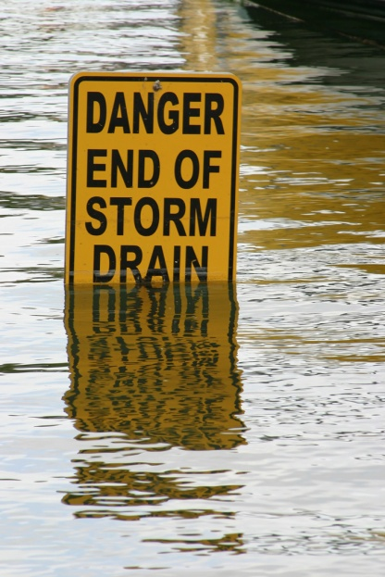
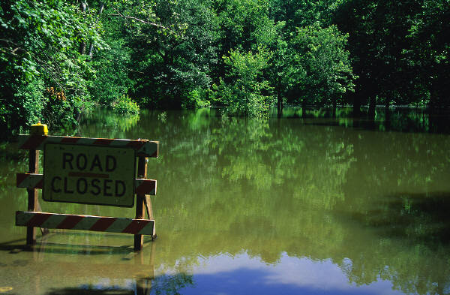
Effects of Floods
Damage to agricultural crops
Damage to life and property
Disturbances in transportation
Increase in populations of disease vectors and pathogens
Loss of biodiversity
Economic crisis
https://www.youtube.com/watch?v=4PXj7bOD7IY
13

Slide 14
Control of Floods
Plantation on slopes: Plant have a tendency to absorb water and reduce the speed of running water. Thus reduce the adverse effect of flood.
Drainage management: Drainage water management is the practice of using a water control structure in the main, submain, (or sometimes lateral) drain to raise the drainage outlet to various depths. This allows farmers to have more control over drainage
Flood plain zoning: Flood plain zoning means dividing the entire flood area into different zones and to restrict the occupancy of the different zones of the flood plain to uses which will suffer little or no damage during floods
Forecasting: Forecasting is the process of making predictions of the future based on past and present data and most commonly by analysis of trends. Early forecasting can reduce the possible adverse effect of flood.
14

Slide 15
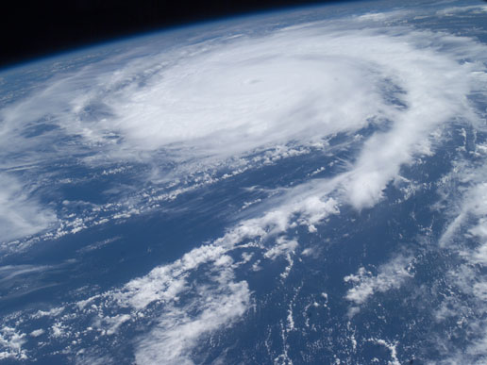
Cyclones
In northern hemisphere, a cyclone refers to an area of low atmospheric pressure surrounded by a wind system in a counter-clockwise direction.
15

Slide 16
Effects of Cyclones
Cyclones generate storm surges.
They damage installations, residences, communication systems, trees, etc., resulting in loss of life and property.
They may cause river floods and submergence of low-lying areas.
They pollute drinking water sources causing outbreak of epidemics.
16

Slide 17
Management of Cyclones
Forecasting: Forecasting is the process of making predictions of the future based on past and present data and most commonly by analysis of trends. Early forecasting can reduce the possible adverse effect of flood.
Proper construction of houses and Construction of cyclone shelters in the cyclone-prone areas
Relief tasks must be completed in minimum time period to avoid more adverse effect of cyclones
Community preparedness at all levels to deal with emergency situations and development of warning systems can provide help in Management of cyclones effects.
17

Slide 18
Tsunami
Series of tall waves that hit the shore with great energy.
Caused by under sea earthquake that set off waves in water.
These waves may last just minutes, but can cause widespread devastation along the coast.
Most occurs in Pacific ocean.
18

Slide 19
Impact of tsunami
Coastal erosion: Coastal erosion is the loss or displacement of land, or the long-term removal of sediment and rocks along the coastline due to the action of waves, currents, etc.
Contamination of ground water and soil with salt water and sewage.
Damage to coral reefs and Mangroves.
Adverse effect on habitat of coastal species.
19

Slide 20
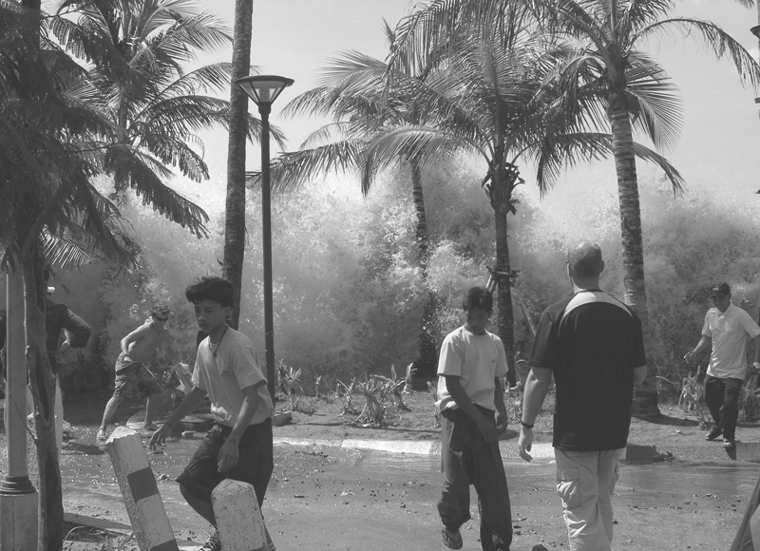
Ex-Asian tsunami
In 2004, Asian tsunami was the biggest ever in history. Hits south-east and south Asia on Dec 26,2004.
Triggered by massive undersea earthquake measuring 9.0 on Richter scale occurred in Sumatra.
230,000 people in 14 countries died.
20

Slide 21
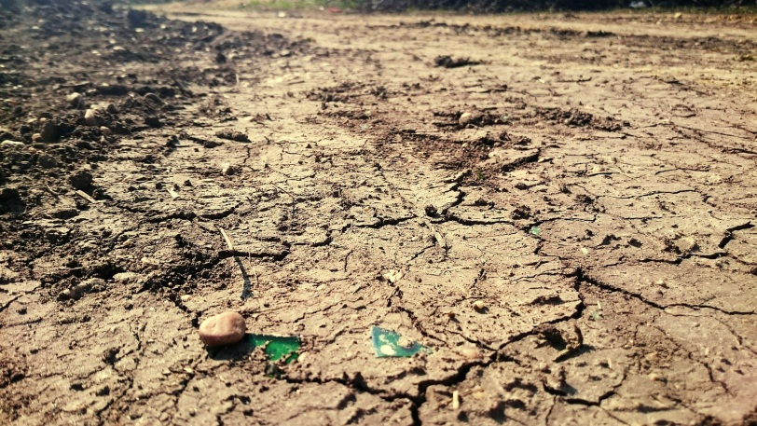
Drought
It is a condition in which the region suffers from severe deficiency in its water supply.
CAUSES-
1)Below average rainfall.
2) Deforestation
3) Over population and unsustainable use of water resources.
4) over farming, excessive irrigation
5) Pollution
21

Slide 22
EFFECTS
1) Water shortages affect the health, well-being, and quality of life of the people.
2) Economic Crisis.
3) Diminished crop growth or yield production-Famine due to lack of water for irrigation
4) Mass migration to other places.
5) Desertification
https://www.youtube.com/watch?v=Xo1Jyzba7rA
22

Slide 23
MANAGEMENT-
Sustainable use of water.
Building water harvesting systems- rain water harvesting.
3) Cloud seeding - a form of intentional weather modification to induce rainfall.
4) Desalination of sea water for irrigation or consumption.
23

Slide 24
Disaster Management
Objectives:
Reduce, or avoid, losses from disasters
Assure prompt assistance to victims
Achieve rapid and effective recovery
Disaster management:
Mitigation: Minimizing the possible effects of a disaster
Preparedness: Planning how to respond to a disaster so that impact of disaster can reduced.
Response: Taking immediate measures to save life and property, providing medical relief, etc.
Recovery: Returning the community to normal conditions
24

Slide 25
Mitigation is the reduction of something harmful or the reduction of its harmful effects. It may refer to measures taken to reduce the harmful effects of hazards that remain in potentia, or to manage harmful incidents that have already occurred. It is a stage or component of emergency management and of risk management.

Slide 26
National Policy on Disaster Management
A holistic, and proactive approach towards prevention, mitigation, and preparedness.
Adequate funds to be set apart for vulnerability reduction and preparedness.
Mitigation measures built into ongoing schemes and programmes.
Projects in hazard-prone areas should include mitigation measures and vulnerability reduction.
National disaster management law to be enacted covering all the existing mechanisms.
25

Slide 27
Important Web-Links-Lecture 25
Reading Material
http://study.com/academy/lesson/what-are-floods-causes-types-prevention.html
https://www.ugc.ac.in/oldpdf/modelcurriculum/env.pdf
Audio visuals
https://www.youtube.com/watch?v=Xo1Jyzba7rA
26

Slide 28
Acknowledgment
Some images, animation, and material have been taken from the following sources:
1- Text Books: PERSPECTIVE IN ENVIRONMENTAL STUDIES by ANUBHA KAUSHIK, C P KAUSHIK, NEW AGE INTERNATIONAL PUBLISHERS
2- References Book: TEXT BOOK OF ENVIRONMENTAL STUDIES by D. DAVE AND S. S. KATEWA, CENGAGE LEARNING
3- All slides can be used for reading purpose only
27

